Slide 1
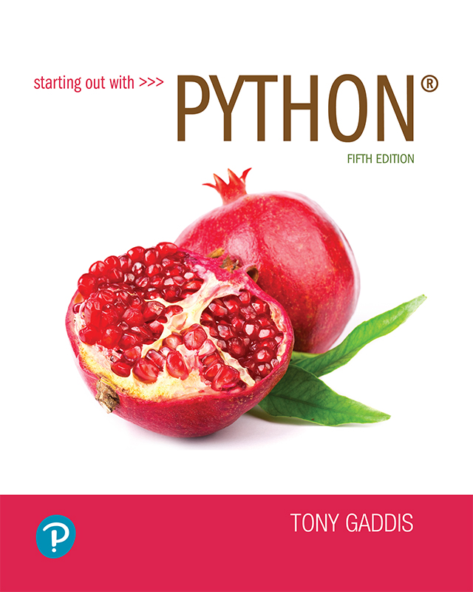
Starting out with Python
Fifth Edition
Chapter 9
Dictionaries and Sets
Copyright © 2021, 2018, 2015 Pearson Education, Inc. All Rights Reserved

Slide 2
Topics
Dictionaries
Sets
Serializing Objects

Slide 3
Dictionaries
Dictionary: object that stores a collection of data
Each element consists of a key and a value
Often referred to as mapping of key to value
Key must be an immutable object
To retrieve a specific value, use the key associated with it
Format for creating a dictionary
dictionary =
{key1:val1, key2:val2}

Slide 4
Retrieving a Value from a Dictionary
Elements in dictionary are unsorted
General format for retrieving value from dictionary: dictionary[key]
If key in the dictionary, associated value is returned, otherwise, KeyError exception is raised
Test whether a key is in a dictionary using the in and not in operators
Helps prevent KeyError exceptions

Slide 5
Adding Elements to an Existing Dictionary
Dictionaries are mutable objects
To add a new key-value pair:
dictionary[key] = value
If key exists in the dictionary, the value associated with it will be changed

Slide 6
Deleting Elements From an Existing Dictionary
To delete a key-value pair:
del dictionary[key]
If key is not in the dictionary, KeyError exception is raised

Slide 7
Getting the Number of Elements and Mixing Data Types
len function: used to obtain number of elements in a dictionary
Keys must be immutable objects, but associated values can be any type of object
One dictionary can include keys of several different immutable types
Values stored in a single dictionary can be of different types

Slide 8
Creating an Empty Dictionary and Using for Loop to Iterate Over a Dictionary
To create an empty dictionary:
Use {}
Use built-in function dict()
Elements can be added to the dictionary as program executes
Use a for loop to iterate over a dictionary
General format: for key in dictionary:

Slide 9
Some Dictionary Methods (1 of 5)
clear method: deletes all the elements in a dictionary, leaving it empty
Format: dictionary.clear()
get method: gets a value associated with specified key from the dictionary
Format: dictionary.get(key, default)
default is returned if key is not found
Alternative to [] operator
Cannot raise KeyError exception

Slide 10
Some Dictionary Methods (2 of 5)
items method: returns all the dictionaries keys and associated values
Format: dictionary.items()
Returned as a dictionary view
Each element in dictionary view is a tuple which contains a key and its associated value
Use a for loop to iterate over the tuples in the sequence
Can use a variable which receives a tuple, or can use two variables which receive key and value

Slide 11
Some Dictionary Methods (3 of 5)
keys method: returns all the dictionaries keys as a sequence
Format: dictionary.keys()
pop method: returns value associated with specified key and removes that key-value pair from the dictionary
Format: dictionary.pop(key, default)
default is returned if key is not found

Slide 12
Some Dictionary Methods (4 of 5)
popitem method: Returns, as a tuple, the key-value pair that was last added to the dictionary. The method also removes the key-value pair from the dictionary.
Format: dictionary.popitem()
Key-value pair returned as a tuple
values method: returns all the dictionaries values as a sequence
Format: dictionary.values()
Use a for loop to iterate over the values

Slide 13
Some Dictionary Methods (5 of 5)
Table 9-1 Some of the dictionary methods
Method | Description
Clear | Clears the contents of a dictionary.
get | Gets the value associated with a specified key. If the key is not found, the method does not raise an exception. Instead, it returns a default value.
items | Returns all the keys in a dictionary and their associated values as a sequence of tuples.
keys | Returns all the keys in a dictionary as a sequence of tuples.
pop | Returns the value associated with a specified key and removes that key-value pair from the dictionary. If the key is not found, the method returns a default value.
popitem | Returns, as a tuple, the key-value pair that was last added to the dictionary. The method also removes the key-value pair from the dictionary.
values | Returns all the values in the dictionary as a sequence of tuples.

Slide 14
Dictionary Comprehensions (1 of 6)
Dictionary comprehension: an expression that reads a sequence of input elements and uses those input elements to produce a dictionary

Slide 15
Dictionary Comprehensions (2 of 6)
Example: create a dictionary in which the keys are the integers 1 through 4 and the values are the squares of the keys
>>> numbers = [1, 2, 3, 4]
>>> squares = {}
>>> for item in numbers:
... squares[item] = item**2
...
>>> squares
{1: 1, 2: 4, 3: 9, 4: 16}
>>>
Using a for loop
Using a dictionary comprehension
>>> squares = {item:item**2 for item in numbers}
>>> squares
{1: 1, 2: 4, 3: 9, 4: 16}
>>>

Slide 16
Dictionary Comprehensions (3 of 6)
squares = {item:item**2 for item in numbers}
Result Expression
Iteration Expression
The iteration expression iterates over the elements of numbers
Each time it iterates, the target variable item is assigned the value of an element
At the end of each iteration, an element containing item as the key and item**2 as the value is added to the new dictionary

Slide 17
Dictionary Comprehensions (4 of 6)
Example: You have an existing list of strings. Create a dictionary in which the keys are the stings in the list, and the values are the lengths of the strings
>>> names = ['Jeremy', 'Kate', 'Peg']
>>> str_lengths = {item:len(item) for item in names}
>>> str_lengths
{'Jeremy': 6, 'Kate': 4, 'Peg': 3}
>>>

Slide 18
Dictionary Comprehensions (5 of 6)
Example: making a copy of a dictionary
>>> dict1 = {'A':1, 'B':2, 'C':3}
>>> dict2 = {k:v for k,v in dict1.items()}
>>> dict2
{'A': 1, 'B': 2, 'C': 3}
>>>

Slide 19
Dictionary Comprehensions (6 of 6)
You can use an if clause in a dictionary comprehension to select only certain elements of the input sequence
Example: A dictionary contains cities and their populations as key-value pairs. Select only the cities with a population greater than 2 million
>>> populations = {'New York': 8398748, 'Los Angeles': 3990456,
... 'Chicago': 2705994, 'Houston': 2325502,
... 'Phoenix': 1660272, 'Philadelphia': 1584138}
>>> largest = {k:v for k,v in populations.items() if v > 2000000}
>>> largest
{'New York': 8398748, 'Los Angeles': 3990456, 'Chicago': 2705994, 'Houston': 2325502}
>>>

Slide 20
Sets
Set: object that stores a collection of data in same way as mathematical set
All items must be unique
Set is unordered
Elements can be of different data types

Slide 21
Creating a Set
set function: used to create a set
For empty set, call set()
For non-empty set, call set(argument) where argument is an object that contains iterable elements
e.g., argument can be a list, string, or tuple
If argument is a string, each character becomes a set element
For set of strings, pass them to the function as a list
If argument contains duplicates, only one of the duplicates will appear in the set

Slide 22
Getting the Number of and Adding Elements
len function: returns the number of elements in the set
Sets are mutable objects
add method: adds an element to a set
update method: adds a group of elements to a set
Argument must be a sequence containing iterable elements, and each of the elements is added to the set

Slide 23
Deleting Elements From a Set
remove and discard methods: remove the specified item from the set
The item that should be removed is passed to both methods as an argument
Behave differently when the specified item is not found in the set
remove method raises a KeyError exception
discard method does not raise an exception
clear method: clears all the elements of the set

Slide 24
Using the for Loop, in, and not in Operators With a Set
A for loop can be used to iterate over elements in a set
General format: for item in set:
The loop iterates once for each element in the set
The in operator can be used to test whether a value exists in a set
Similarly, the not in operator can be used to test whether a value does not exist in a set

Slide 25
Finding the Union of Sets
Union of two sets: a set that contains all the elements of both sets
To find the union of two sets:
Use the union method
Format: set1.union(set2)
Use the | operator
Format: set1 | set2
Both techniques return a new set which contains the union of both sets

Slide 26
Finding the Intersection of Sets
Intersection of two sets: a set that contains only the elements found in both sets
To find the intersection of two sets:
Use the intersection method
Format: set1.intersection(set2)
Use the & operator
Format: set1 & set2
Both techniques return a new set which contains the intersection of both sets

Slide 27
Finding the Difference of Sets
Difference of two sets: a set that contains the elements that appear in the first set but do not appear in the second set
To find the difference of two sets:
Use the difference method
Format: set1.difference(set2)
Use the - operator
Format: set1 - set2

Slide 28
Finding the Symmetric Difference of Sets
Symmetric difference of two sets: a set that contains the elements that are not shared by the two sets
To find the symmetric difference of two sets:
Use the symmetric_difference method
Format: set1.symmetric_difference(set2)
Use the ^ operator
Format: set1 ^ set2

Slide 29
Finding Subsets and Supersets (1 of 2)
Set A is subset of set B if all the elements in set A are included in set B
To determine whether set A is subset of set B
Use the issubset method
Format: setA.issubset(setB)
Use the <= operator
Format: setA <= setB

Slide 30
Finding Subsets and Supersets (2 of 2)
Set A is superset of set B if it contains all the elements of set B
To determine whether set A is superset of set B
Use the issuperset method
Format: setA.issuperset(setB)
Use the >= operator
Format: setA >= setB

Slide 31
Set Comprehensions (1 of 4)
Set comprehension: a concise expression that creates a new set by iterating over the elements of a sequence
Set comprehensions are written just like list comprehensions, except that a set comprehension is enclosed in curly braces ({}) instead of brackets ([])

Slide 32
Set Comprehensions (2 of 4)
Example: making a copy of a set
>>> set1 = set([1, 2, 3, 4, 5])
>>> set2 = {item for item in set1}
>>> set2
{1, 2, 3, 4, 5}
>>>

Slide 33
Set Comprehensions (3 of 4)
Example: creating a set that contains the squares of the numbers stored in another set
>>> set1 = set([1, 2, 3, 4, 5])
>>> set2 = {item**2 for item in set1}
>>> set2
{1, 4, 9, 16, 25}
>>>

Slide 34
Set Comprehensions (4 of 4)
Example: copying the numbers in a set that are less than 10
>>> set1 = set([1, 20, 2, 40, 3, 50])
>>> set2 = {item for item in set1 if item < 10}
>>> set2
{1, 2, 3}
>>>

Slide 35
Serializing Objects (1 of 3)
Serialize an object: convert the object to a stream of bytes that can easily be stored in a file
Pickling: serializing an object

Slide 36
Serializing Objects (2 of 3)
To pickle an object:
Import the pickle module
Open a file for binary writing
Call the pickle.dump function
Format: pickle.dump(object, file)
Close the file
You can pickle multiple objects to one file prior to closing the file

Slide 37
Serializing Objects (3 of 3)
Unpickling: retrieving pickled object
To unpickle an object:
Import the pickle module
Open a file for binary writing
Call the pickle.load function
Format: pickle.load(file)
Close the file
You can unpickle multiple objects from the file

Slide 38
Summary (1 of 2)
This chapter covered:
Dictionaries, including:
Creating dictionaries
Inserting, retrieving, adding, and deleting key-value pairs
for loops and in and not in operators
Dictionary methods

Slide 39
Summary (2 of 2)
This chapter covered (cont’d):
Sets:
Creating sets
Adding elements to and removing elements from sets
Finding set union, intersection, difference and symmetric difference
Finding subsets and supersets
Serializing objects
Pickling and unpickling objects

